Slide 1
Randomized Algorithms CS648
Lecture 9
Random Sampling
part-I
(To find a subset
with a desired property)

Slide 2
A real life example
We need a donor with blood group O+.
There is a huge list (1 million) of blood donors.
Unfortunately, the blood group information of donors is lost .
What to do ?
IDEA:
Repeat until we get a donor of blood group O+.
{ Pick phone number of a donor randomly uniformly
Call him to ask his Blood group.
}
37% people are O+
(Select a random subset of donors.)

Slide 3
Random Sampling
Suppose there is a computational problem
where we require to find a subset with some desired properties.
Unfortunately, computing such a set deterministically may take huge time.
Random sampling carried out suitably
may produce a subset with the desired property with some probability.

Slide 4
Random Sampling
(To efficiently find a subset
with a desired property)

Slide 5
Randomized Algorithm for
BPWM problem
(Boolean Product Witness Matrix)

Slide 6

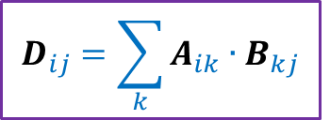

Integer Product of Matrices
Boolean
$$j$$
1 | 0 | 0 | 1 | 0
1 | 0 | 0 | 0 | 1
0 | 0 | 1 | 0 | 0
0 | 1 | 0 | 1 | 0
1 | 1 | 0 | 1 | 0
1 | 0 | 1 | 0 | 0
0 | 1 | 1 | 0 | 1
1 | 1 | 1 | 1 | 0
1 | 1 | 1 | 0 | 0
1 | 0 | 0 | 1 | 0
2 | 1 | 2 | 0 | 0
2 | 0 | 1 | 0 | 0
1 | 1 | 1 | 1 | 0
1 | 2 | 2 | 0 | 1
2 | 2 | 3 | 0 | 1
$$i$$
A
B
D
$$D_{ij}=\sum_{k}{A_{ik}{∙B}_{kj}}$$

Slide 7
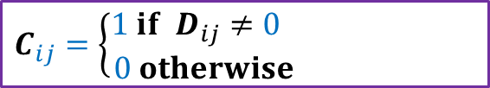
Boolean Product of Matrices
$$j$$
1 | 0 | 0 | 1 | 0
1 | 0 | 0 | 0 | 1
0 | 0 | 1 | 0 | 0
0 | 1 | 0 | 1 | 0
1 | 1 | 0 | 1 | 0
1 | 0 | 0 | 1 | 0
1 | 0 | 0 | 0 | 1
0 | 0 | 1 | 0 | 0
0 | 1 | 0 | 1 | 0
1 | 1 | 0 | 1 | 0
1 | 0 | 1 | 0 | 0
0 | 1 | 1 | 0 | 1
1 | 1 | 1 | 1 | 0
1 | 1 | 1 | 0 | 0
1 | 0 | 0 | 1 | 0
1 | 1 | 1 | 0 | 0
1 | 0 | 1 | 0 | 0
1 | 1 | 1 | 1 | 0
1 | 1 | 1 | 0 | 1
1 | 1 | 1 | 0 | 1
$$i$$
A
B
C
$$C_{ij}=\left\{\begin{aligned}1 if D_{ij}≠0 \\ 0 otherwise \end{aligned}\right.$$

Slide 8
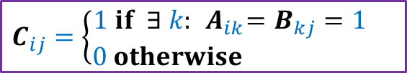
Boolean Product of Matrices
$$j$$
1 | 0 | 0 | 1 | 0
1 | 0 | 0 | 0 | 1
0 | 0 | 1 | 0 | 0
0 | 1 | 0 | 1 | 0
1 | 1 | 0 | 1 | 0
1 | 0 | 0 | 1 | 0
1 | 0 | 0 | 0 | 1
0 | 0 | 1 | 0 | 0
0 | 1 | 0 | 1 | 0
1 | 1 | 0 | 1 | 0
1 | 0 | 1 | 0 | 0
0 | 1 | 1 | 0 | 1
1 | 1 | 1 | 1 | 0
1 | 1 | 1 | 0 | 0
1 | 0 | 0 | 1 | 0
1 | 1 | 1 | 0 | 0
1 | 0 | 1 | 0 | 0
1 | 1 | 1 | 1 | 0
1 | 1 | 1 | 0 | 1
1 | 1 | 1 | 0 | 1
$$i$$
A
B
C
$$C_{ij}=\left\{\begin{aligned}1 if ∃ k:{ A}_{ik}=B_{kj}=1 \\ 0 otherwise \end{aligned}\right.$$
Definition: An integer $k∈[n]$is said to be witness for a pair ($i,j$) if ${ A}_{ik}=B_{kj}=1$

Slide 9

Boolean Product Witness Matrix (BPWM)
Problem:
Given two Boolean matrices A and B, and their Boolean product C,
compute a matrix $W$, such that:
$W_{ij}$ stores a witness for each ($i,j$) with $C_{ij}=1$.

Slide 10
Motivation for BPWM

Slide 11





All Pairs Shortest Paths (APSP)
Standard Algorithms:
Floyd Warshal Algorithm
Dijkstra’s Algorithm
BFS traversal (for unweighted graphs)
O$(n^{3})$ time in the worst case
Raimund Seidel,
JCSS, 51(3): 400-403 ,$1995$
APSP
Matrix Multiplication
O$(n^{ω}\log^{2}{n})$ time
O$(n^{ω})$ time
$ω$<$2.317$

Slide 12
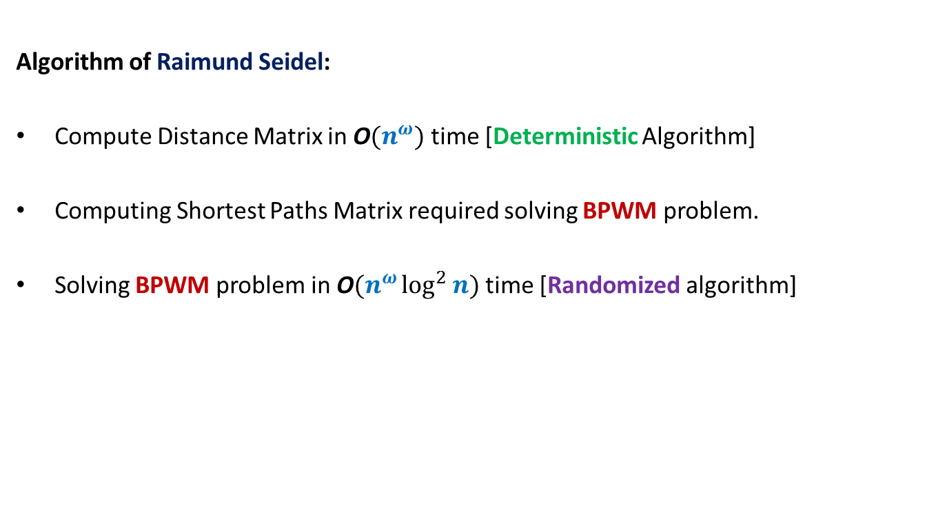
All Pairs Shortest Paths (APSP)
Students having interest in algorithms are strongly advised to study this novel algorithm from Motwani-Raghwan book or the original journal version. (This is, of course, not part of the syllabus for CS648)
Algorithm of Raimund Seidel:
Compute Distance Matrix in O$(n^{ω})$ time [Deterministic Algorithm]
Computing Shortest Paths Matrix required solving BPWM problem.
Solving BPWM problem in O$(n^{ω}\log^{2}{n})$ time [Randomized algorithm]

Slide 13
Randomized algorithm for BPWM

Slide 14

Boolean Product Witness Matrix (BPWM)
Problem: Given two Boolean matrices A and B, and their Boolean product C,
compute a matrix $W$, such that:
$W_{ij}$ stores a witness for each ($i,j$) with $C_{ij}=1$.
Let us make some simple observations first.

Slide 15


Observations
$$j$$
1 | 0 | 0 | 1 | 0
1 | 0 | 0 | 0 | 1
0 | 0 | 1 | 0 | 0
0 | 1 | 0 | 1 | 0
1 | 1 | 0 | 1 | 0
1 | 0 | 1 | 0 | 0
0 | 1 | 1 | 0 | 1
1 | 1 | 1 | 1 | 0
1 | 1 | 1 | 0 | 0
1 | 0 | 0 | 1 | 0
1 | 1 | 1 | 0 | 0
1 | 0 | 1 | 0 | 0
1 | 1 | 1 | 1 | 0
1 | 1 | 1 | 0 | 1
1 | 1 | 1 | 0 | 1
$$i$$
A
B
C
There may be many witnesses for a pair ($i,j$) .
But our aim is to compute “just one witness” for each pair.
Witnesses for ($i$,$j$)

Slide 16

Observations
$$j$$
1 | 0 | 0 | 1 | 0
1 | 0 | 0 | 0 | 1
0 | 0 | 1 | 0 | 0
0 | 1 | 0 | 1 | 0
1 | 1 | 0 | 1 | 0
1 | 0 | 1 | 0 | 0
0 | 1 | 1 | 0 | 1
1 | 1 | 1 | 1 | 0
1 | 1 | 1 | 0 | 0
1 | 0 | 0 | 1 | 0
1 | 1 | 1 | 0 | 0
1 | 0 | 1 | 0 | 0
1 | 1 | 1 | 1 | 0
1 | 1 | 1 | 0 | 1
1 | 1 | 1 | 0 | 1
$$i$$
A
B
C
How efficiently can we search a witnesses for a pair ($i,j$) ?
O($n$) time

Slide 17


Observations
$$j$$
1 | 0 | 0 | 1 | 0
1 | 0 | 0 | 0 | 1
0 | 0 | 1 | 0 | 0
0 | 1 | 0 | 1 | 0
1 | 1 | 0 | 1 | 0
1 | 0 | 1 | 0 | 0
0 | 1 | 1 | 0 | 1
1 | 1 | 1 | 1 | 0
1 | 1 | 1 | 0 | 0
1 | 0 | 0 | 1 | 0
1 | 1 | 1 | 0 | 0
1 | 0 | 1 | 0 | 0
1 | 1 | 1 | 1 | 0
1 | 1 | 1 | 0 | 1
1 | 1 | 1 | 0 | 1
$$i$$
A
B
C
How efficiently can you verify if $k$ is a witness for a pair ($i,j$) ?
Just check whether${ A}_{ik}=B_{kj}=1$.
O($1$) time

Slide 18



Boolean Product of Matrices
$$j$$
1 | 0 | 0 | 1 | 0
1 | 0 | 0 | 0 | 1
0 | 0 | 1 | 0 | 0
0 | 1 | 0 | 1 | 0
1 | 1 | 0 | 1 | 0
1 | 0 | 1 | 0 | 0
0 | 1 | 1 | 0 | 1
1 | 1 | 1 | 1 | 0
1 | 1 | 1 | 0 | 0
1 | 0 | 0 | 1 | 0
1 | 1 | 1 | 0 | 0
1 | 0 | 1 | 0 | 0
1 | 1 | 1 | 1 | 0
1 | 1 | 1 | 0 | 1
1 | 1 | 1 | 0 | 1
$$i$$
A
B
C
Look carefully at the integer product matrix D. Does it have any thing to do with witnesses.
$D_{ij}$= number of witnesses for ($i,j$)
Integer
Product
2 | 1 | 2 | 0 | 0
2 | 0 | 1 | 0 | 0
1 | 1 | 1 | 1 | 0
1 | 2 | 2 | 0 | 1
2 | 2 | 3 | 0 | 1
So it is worth studying $D$ for our problem
$$D_{ij}=\sum_{k}{A_{ik}{∙B}_{kj}}$$
D
Notes:
C just stores 0-1 entries and does not provide any information about witnesses.
Let us look at matrix D which stores some numbers …

Slide 19
Integer Product of Matrices
1 | 0 | 0 | 1 | 0
1 | 0 | 0 | 0 | 1
0 | 0 | 1 | 0 | 0
0 | 1 | 0 | 1 | 0
1 | 1 | 0 | 1 | 0
1 | 0 | 1 | 0 | 0
0 | 1 | 1 | 0 | 1
1 | 1 | 1 | 1 | 0
1 | 1 | 1 | 0 | 0
1 | 0 | 0 | 1 | 0
2 | 1 | 2 | 0 | 0
2 | 0 | 1 | 0 | 0
1 | 1 | 1 | 1 | 0
1 | 2 | 2 | 0 | 1
2 | 2 | 3 | 0 | 1
A
B
D

Slide 20
Integer Product of Matrices
1 | 0 | 0 | 1 | 0
1 | 0 | 0 | 0 | 1
0 | 0 | 1 | 0 | 0
0 | 1 | 0 | 1 | 0
1 | 1 | 0 | 1 | 0
1 | 0 | 1 | 0 | 0
0 | 1 | 1 | 0 | 1
1 | 1 | 1 | 1 | 0
1 | 1 | 1 | 0 | 0
1 | 0 | 0 | 1 | 0
2 | 1 | 2 | 0 | 0
2 | 0 | 1 | 0 | 0
1 | 1 | 1 | 1 | 0
1 | 2 | 2 | 0 | 1
2 | 2 | 3 | 0 | 1
A
B
D

Slide 21
Integer Product of Matrices
1
2
3
4
5
⨯
⨯
⨯
⨯
⨯
1 | 0 | 0 | 1 | 0
1 | 0 | 0 | 0 | 1
0 | 0 | 1 | 0 | 0
0 | 1 | 0 | 1 | 0
1 | 1 | 0 | 1 | 0
1 | 0 | 1 | 0 | 0
0 | 1 | 1 | 0 | 1
1 | 1 | 1 | 1 | 0
1 | 1 | 1 | 0 | 0
1 | 0 | 0 | 1 | 0
2 | 1 | 2 | 0 | 0
2 | 0 | 1 | 0 | 0
1 | 1 | 1 | 1 | 0
1 | 2 | 2 | 0 | 1
2 | 2 | 3 | 0 | 1
A
B
D
There is a way to manipulate A so that D will store a witness for all those pairs which have singleton witness. Can you guess ?

Slide 22
Integer Product of Matrices
1
2
3
4
5
⨯
⨯
⨯
⨯
⨯
1 | 0 | 0 | 1 | 0
1 | 0 | 0 | 0 | 1
0 | 0 | 1 | 0 | 0
0 | 1 | 0 | 1 | 0
1 | 1 | 0 | 1 | 0
1 | 0 | 1 | 0 | 0
0 | 1 | 1 | 0 | 1
1 | 1 | 1 | 1 | 0
1 | 1 | 1 | 0 | 0
1 | 0 | 0 | 1 | 0
2 | 4 | 2 | 0 | 0
2 | 0 | 1 | 0 | 0
3 | 3 | 3 | 3 | 0
2 | 2 | 2 | 0 | 2
2 | 2 | 3 | 0 | 2
A
B
D

Slide 23
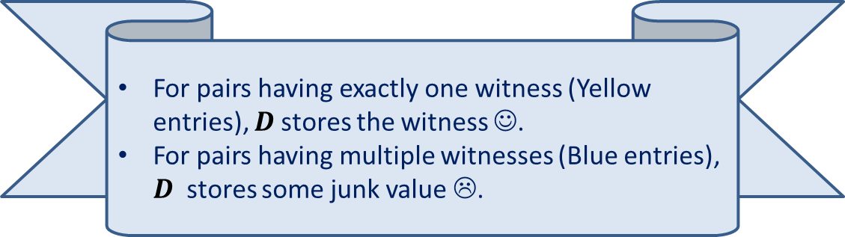
Integer Product of Matrices
1 2 3 4 5
⨯ ⨯ ⨯ ⨯ ⨯
1 | 0 | 0 | 1 | 0
1 | 0 | 0 | 0 | 1
0 | 0 | 1 | 0 | 0
0 | 1 | 0 | 1 | 0
1 | 1 | 0 | 1 | 0
1 | 0 | 1 | 0 | 0
0 | 1 | 1 | 0 | 1
1 | 1 | 1 | 1 | 0
1 | 1 | 1 | 0 | 0
1 | 0 | 0 | 1 | 0
5 | 4 | 5 | 0 | 0
6 | 0 | 1 | 0 | 0
3 | 3 | 3 | 3 | 0
2 | 6 | 6 | 0 | 2
5 | 6 | 7 | 0 | 2
A
B
D
For pairs having exactly one witness (Yellow entries), $D$stores the witness ☺.
For pairs having multiple witnesses (Blue entries), $D$ stores some junk value ☹.

Slide 24

Algorithm for Computing Singleton Witnesses
Compute-Singleton-Witnesses($A$,$B$)
{ For each $i,k∈[n]$
$A_{ik}$← $k$∙ $A_{ik}$;
$D′$← $A$ ∙ $B$;
For each $i,j∈[n]$
If $D_{ij}^{′}$ is a witness for ($i,j$)
$W_{ij}$← $D_{ij}^{′}$
}
Time complexity: O$(n^{ω})$
A deterministic Algorithm

Slide 25
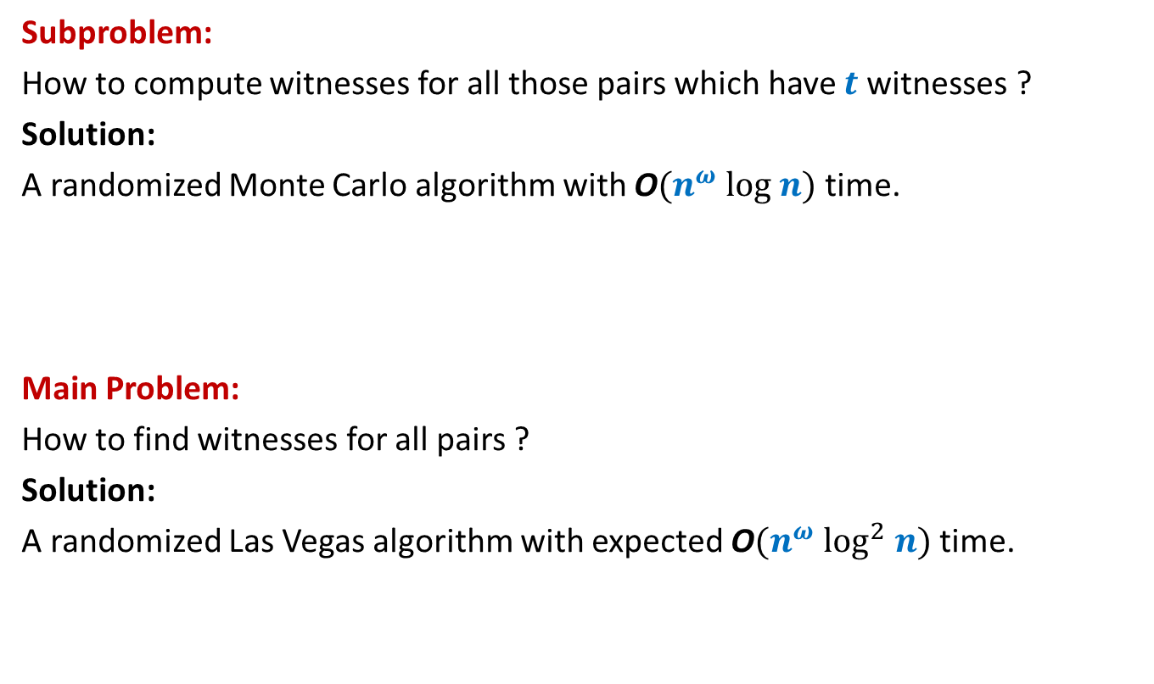
Algorithm Design for BPWM
Subproblem:
How to compute witnesses for all those pairs which have $t$witnesses ?
Solution:
A randomized Monte Carlo algorithm with O$(n^{ω} log n)$ time.
Main Problem:
How to find witnesses for all pairs ?
Solution:
A randomized Las Vegas algorithm with expected O$(n^{ω} \log^{2} n)$ time.
?

Slide 26
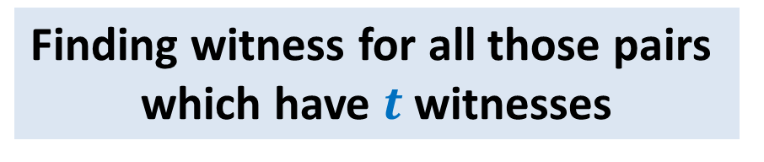

Randomized O$(n^{ω} log n)$ Algorithm:
Finding witness for all those pairs
which have $t$witnesses

Slide 27

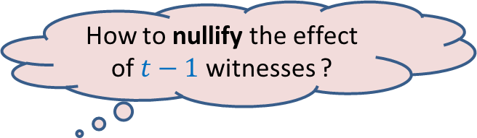
Focus on a single pair ($i$,$j$)
$$j$$
1 2 3 4 … n
⨯ ⨯ ⨯ ⨯ ⨯ ⨯ ⨯ ⨯ ⨯ ⨯
1 | 0 | 1 | 1 | 1 | 0 | 0 | 1 | 0 | 1
 |  |  |  |  |  |  | 1
 |  |  |  |  |  |  | 1
 |  |  |  |  |  |  | 0
 |  |  |  |  |  |  | 1
 |  |  |  |  |  |  | 1
 |  |  |  |  |  |  | 0
 |  |  |  |  |  |  | 1
 |  |  |  |  |  |  | 1
 |  |  |  |  |  |  | 0
 |  |  |  |  |  |  | 0
$$i$$
A
B
How to nullify the effect of $t−1$witnesses ?
Witnesses for ($i$,$j$)

Slide 28
Focus on a single pair ($i$,$j$)
$$j$$
1 2 3 4 … n
⨯ ⨯ ⨯ ⨯ ⨯ ⨯ ⨯ ⨯ ⨯ ⨯
1 | 0 | 1 | 1 | 1 | 0 | 0 | 1 | 0 | 1
 |  |  |  |  |  |  | 1
 |  |  |  |  |  |  | 1
 |  |  |  |  |  |  | 0
 |  |  |  |  |  |  | 1
 |  |  |  |  |  |  | 1
 |  |  |  |  |  |  | 0
 |  |  |  |  |  |  | 1
 |  |  |  |  |  |  | 1
 |  |  |  |  |  |  | 0
 |  |  |  |  |  |  | 0
$$i$$
A
B

Slide 29
Focus on a single pair ($i$,$j$)
$$j$$
1 2 3 4 5 … n-1 n
⨯ ⨯ ⨯ ⨯ ⨯ ⨯ ⨯ ⨯ ⨯ ⨯
1 | 0 | 1 | 1 | 1 | 0 | 0 | 1 | 0 | 1
 |  |  |  |  |  |  | 1
 |  |  |  |  |  |  | 1
 |  |  |  |  |  |  | 0
 |  |  |  |  |  |  | 1
 |  |  |  |  |  |  | 1
 |  |  |  |  |  |  | 0
 |  |  |  |  |  |  | 1
 |  |  |  |  |  |  | 1
 |  |  |  |  |  |  | 0
 |  |  |  |  |  |  | 0
$$i$$
A
B

Slide 30

Focus on a single pair ($i$,$j$)
$$j$$
0 2 3 0 5 … n-1 0
⨯ ⨯ ⨯ ⨯ ⨯ ⨯ ⨯ ⨯ ⨯ ⨯
1 | 0 | 1 | 1 | 1 | 0 | 0 | 1 | 0 | 1
 |  |  |  |  |  |  | 1
 |  |  |  |  |  |  | 1
 |  |  |  |  |  |  | 0
 |  |  |  |  |  |  | 1
 |  |  |  |  |  |  | 1
 |  |  |  |  |  |  | 0
 |  |  |  |  |  |  | 1
 |  |  |  |  |  |  | 1
 |  |  |  |  |  |  | 0
 |  |  |  |  |  |  | 0
$$i$$
A
B
$D_{ij}$ will store this witness for ($i$,$j$) now ☺.

Slide 31
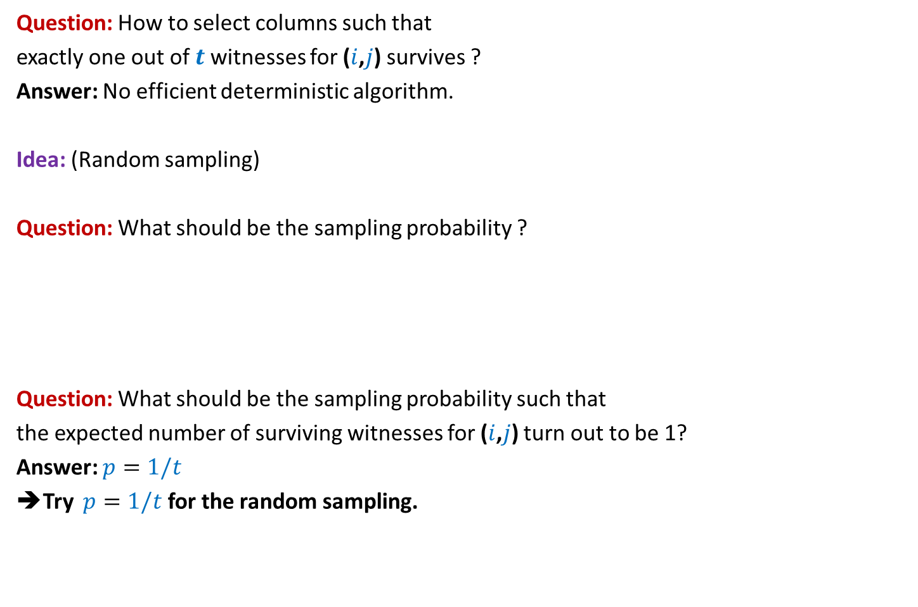
Focus on a single pair ($i$,$j$)
Question: How to select columns such that
exactly one out of $t$witnesses for ($i$,$j$) survives ?
Answer: No efficient deterministic algorithm.
Idea: (Random sampling)
Question: What should be the sampling probability ?
Question: What should be the sampling probability such that
the expected number of surviving witnesses for ($i$,$j$) turn out to be 1?
Answer: $p=1/t$
➔Try $p=1/t$ for the random sampling.
No idea!
Let us ask the following related but easier question.

Slide 32

Focus on a single pair ($i$,$j$)
Question:
If each column is selected independently with $p=1/t$ ,
what is the probability that exactly one out of $t$witnesses for ($i$,$j$) survives ?
Answer:
=$\left({t \atop 1}\right)\frac{1}{t}{\left(1−\frac{1}{t}\right)}^{t−1}$
=${\left(1−\frac{1}{t}\right)}^{t−1}$
= $\frac{1}{2} , \frac{4}{9} , \frac{27}{64} , …, \frac{1}{e}$
$≥\frac{1}{e}$

Slide 33


Randomized algorithm for Computing Witnesses for all pairs with $t$witnesses
//The pseudo code for sampling the (indices of) columns
Sample($n$, $p$)
{ $R$← $∅$;
For each $k∈[n]$ do:
add $k$to $R$ with probability $p$;
return $R$;
}

Slide 34
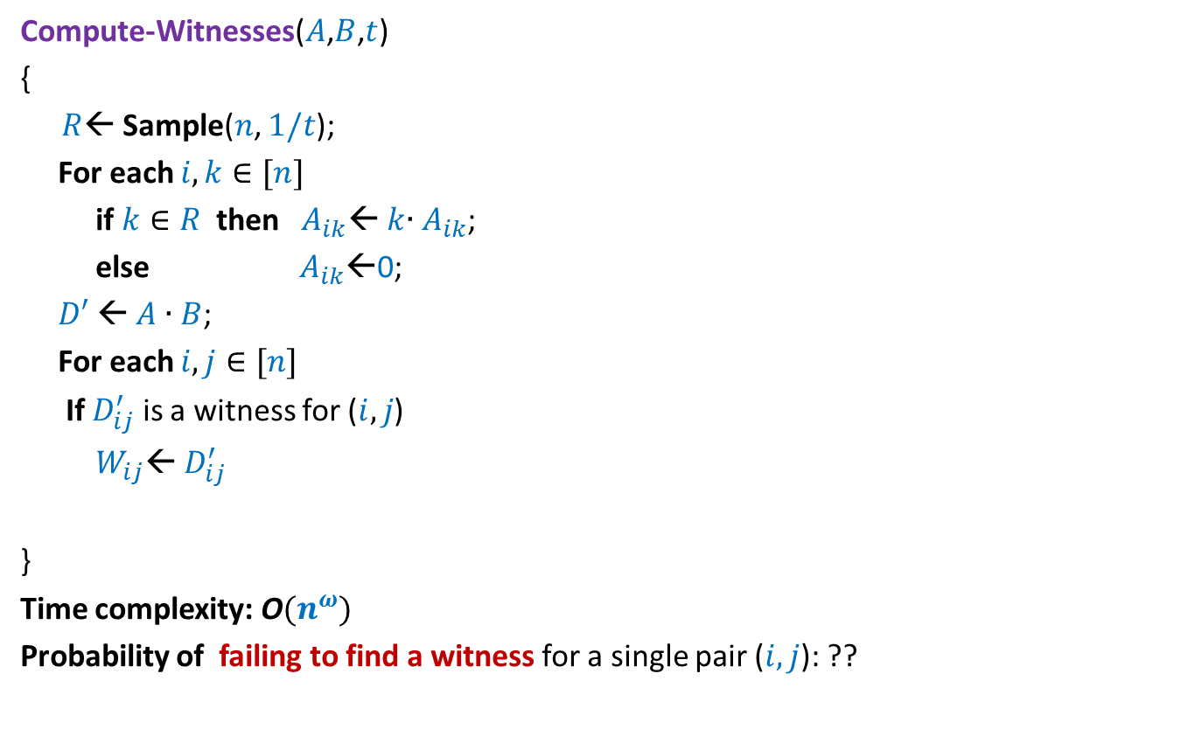

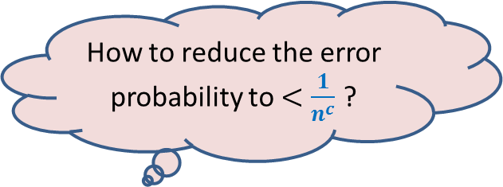
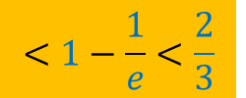
Randomized algorithm for Computing Witnesses for all pairs with $t$witnesses
Compute-Witnesses($A$,$B$,$t$)
{
{ $R$← Sample($n$, $1/t$);
For each $i,k∈[n]$
if $k∈R$ then $A_{ik}$← $k$∙ $A_{ik}$;
else $A_{ik}$←0;
$D′$← $A$ ∙ $B$;
For each $i,j∈[n]$
If $D_{ij}^{′}$ is a witness for ($i,j$)
$W_{ij}$← $D_{ij}^{′}$
}
}
Time complexity: O$(n^{ω})$
Probability of failing to find a witness for a single pair ($i,j$): ??
How to reduce the error probability to $<\frac{1}{n^{c}}$ ?
Repeat the entire process
${c log}_{3/2} n$ times.
$$<1−\frac{1}{e}<\frac{2}{3}$$

Slide 35
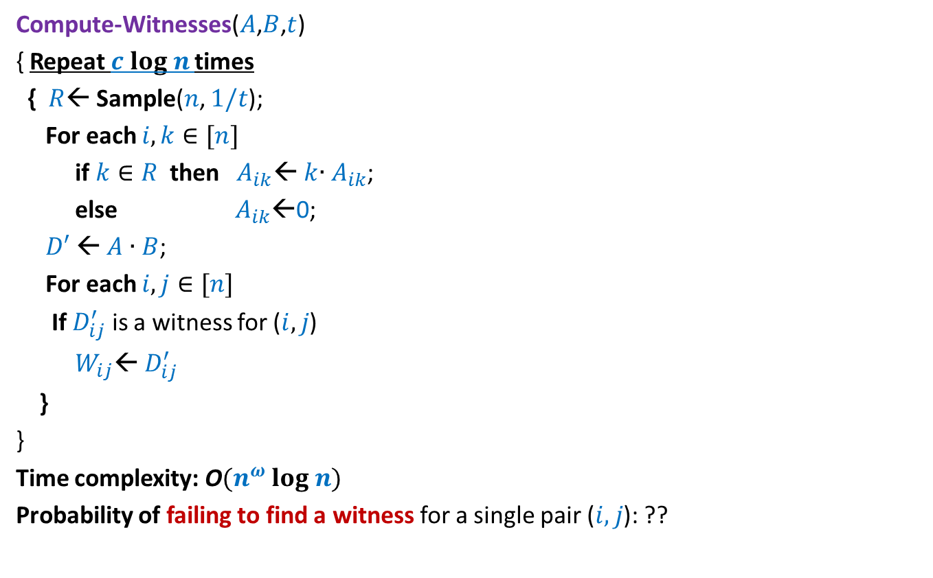
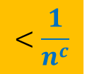
Randomized algorithm for Computing Witnesses for all pairs with $t$witnesses
Compute-Witnesses($A$,$B$,$t$)
{ Repeat $c log n$times
{ $R$← Sample($n$, $1/t$);
For each $i,k∈[n]$
if $k∈R$ then $A_{ik}$← $k$∙ $A_{ik}$;
else $A_{ik}$←0;
$D′$← $A$ ∙ $B$;
For each $i,j∈[n]$
If $D_{ij}^{′}$ is a witness for ($i,j$)
$W_{ij}$← $D_{ij}^{′}$
}
}
Time complexity: O$(n^{ω} log n)$
Probability of failing to find a witness for a single pair ($i,j$): ??
$$<\frac{1}{n^{c}}$$

Slide 36
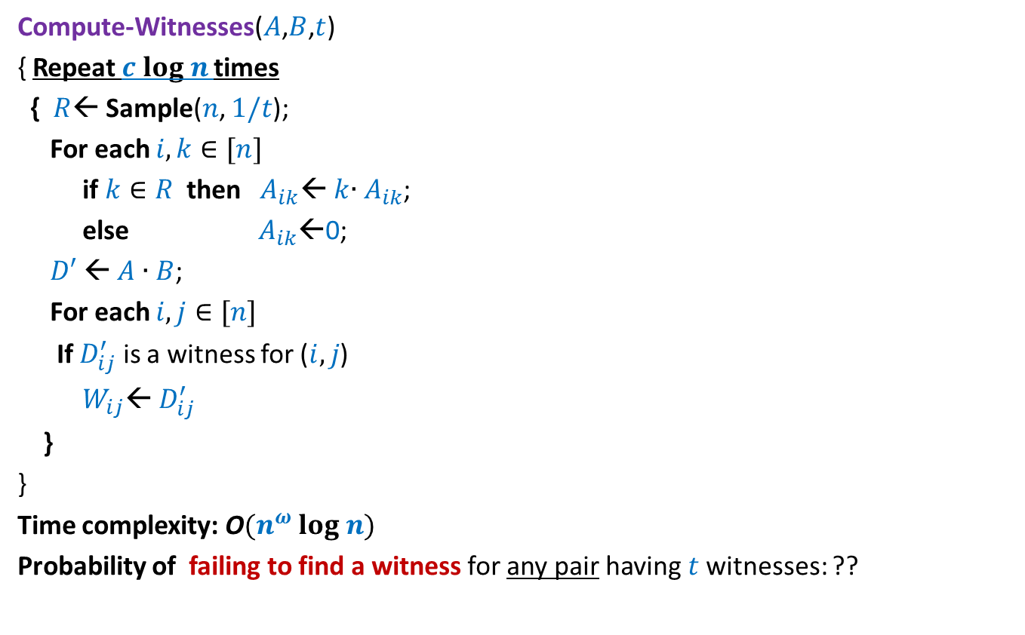
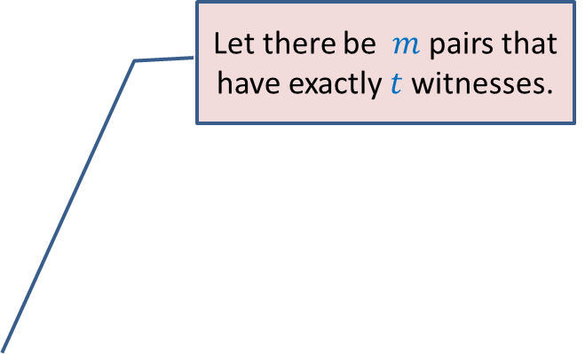

Randomized algorithm for Computing Witnesses for all pairs with $t$witnesses
Compute-Witnesses($A$,$B$,$t$)
{ Repeat $c log n$times
{ $R$← Sample($n$, $1/t$);
For each $i,k∈[n]$
if $k∈R$ then $A_{ik}$← $k$∙ $A_{ik}$;
else $A_{ik}$←0;
$D′$← $A$ ∙ $B$;
For each $i,j∈[n]$
If $D_{ij}^{′}$ is a witness for ($i,j$)
$W_{ij}$← $D_{ij}^{′}$
}
}
Time complexity: O$(n^{ω} log n)$
Probability of failing to find a witness for any pair having $t$witnesses: ??
Apply Union theorem …
Let there be $m$ pairs that have exactly $t$witnesses.
$<\frac{m}{n^{c}}$ < $\frac{1}{n^{c−2}}$

Slide 37
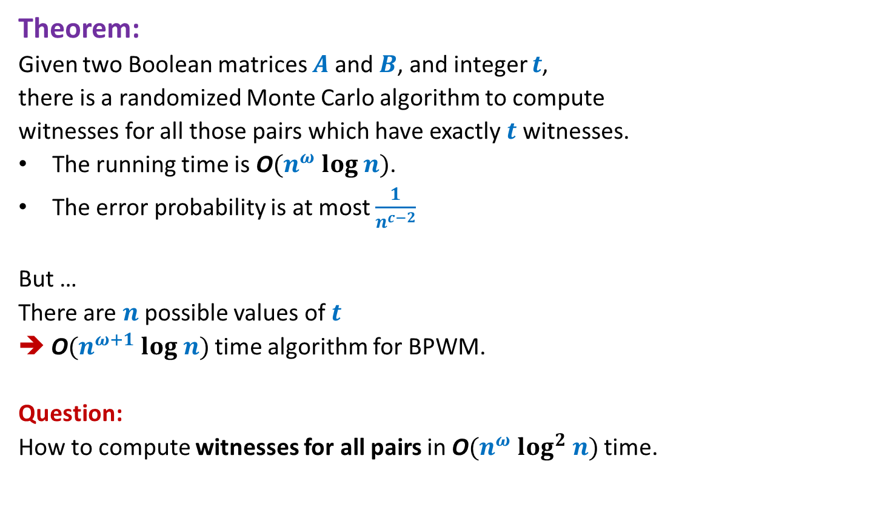
Theorem:
Given two Boolean matrices $A$and $B$, and integer $t$,
there is a randomized Monte Carlo algorithm to compute
witnesses for all those pairs which have exactly $t$ witnesses.
The running time is O$(n^{ω} log n)$.
The error probability is at most $\frac{1}{n^{c−2}}$
But …
There are $n$possible values of $t$
➔ O$(n^{ω+1} log n)$ time algorithm for BPWM.
Question:
How to compute witnesses for all pairs in O$(n^{ω} log^{2} n)$ time.

Slide 38
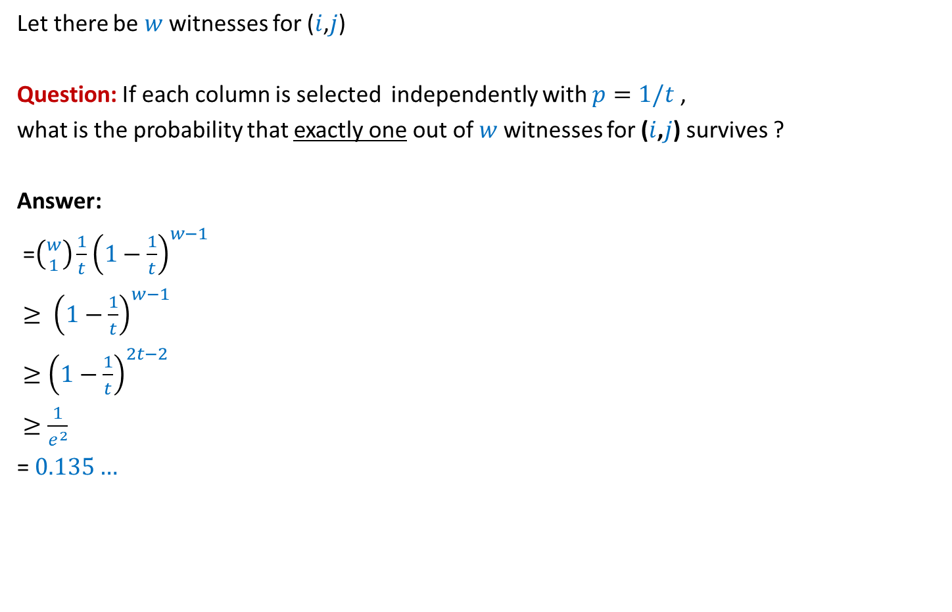
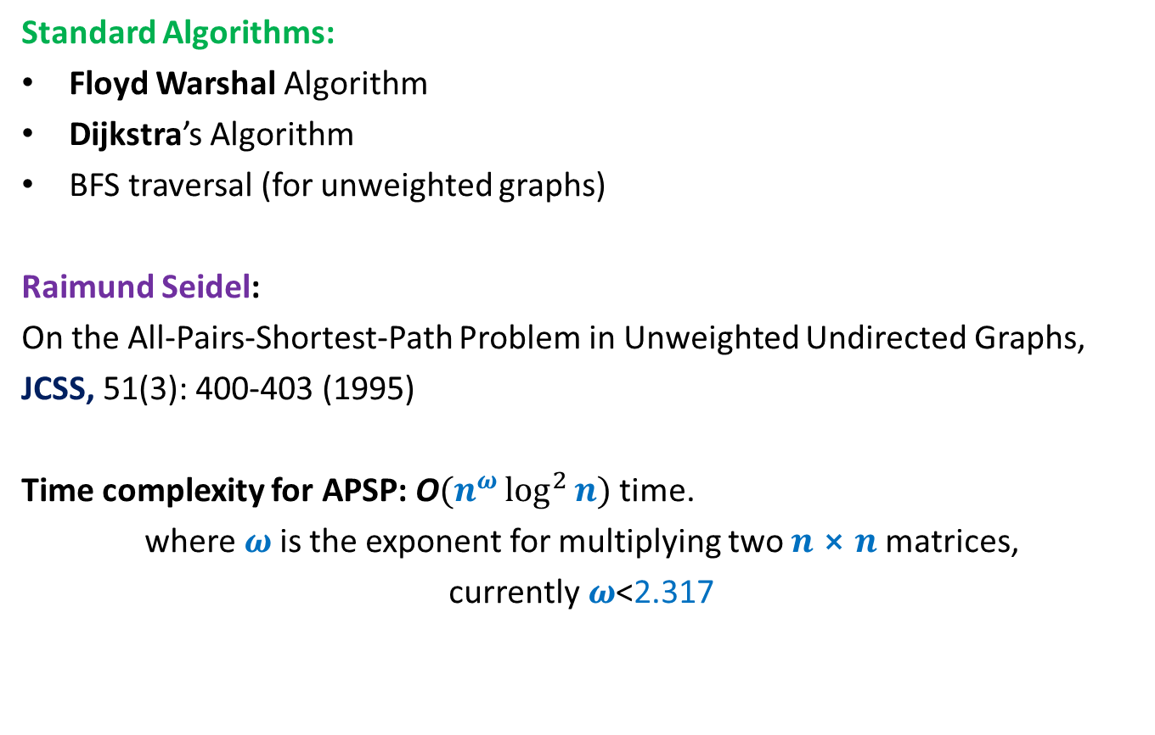
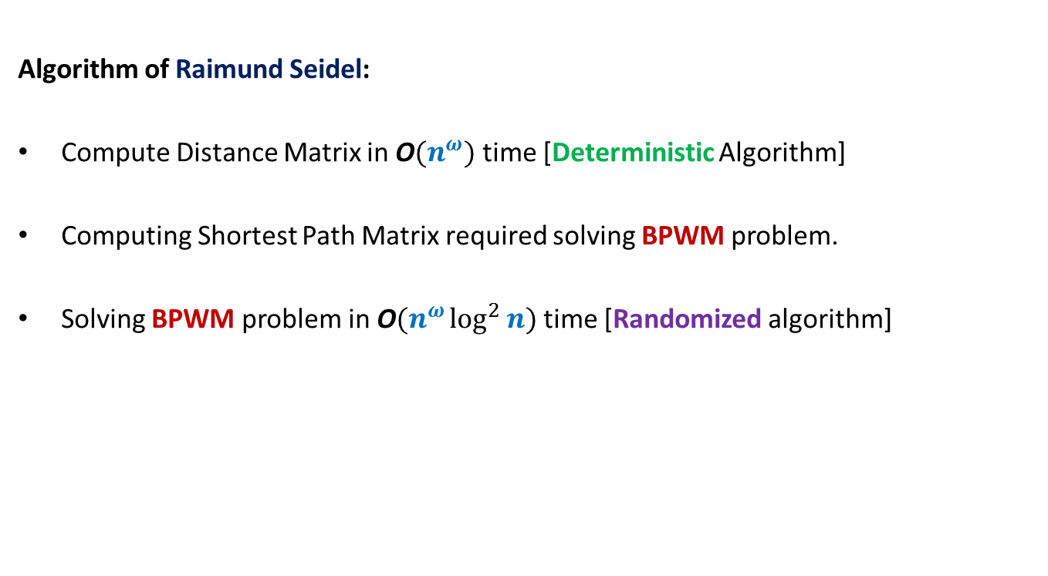
Focus on a single pair ($i$,$j$)
Let there be $w$ witnesses for ($i$,$j$)
Question: If each column is selected independently with $p=1/t$ ,
what is the probability that exactly one out of $w$witnesses for ($i$,$j$) survives ?
Answer:
=$\left({w \atop 1}\right)\frac{1}{t}{\left(1−\frac{1}{t}\right)}^{w−1}$
$≥ {\left(1−\frac{1}{t}\right)}^{w−1}$
$≥{\left(1−\frac{1}{t}\right)}^{2t−2}$
$≥\frac{1}{e^{2}}$
= $0.135…$
such that $t≤w<2t$
$$>\frac{1}{8}$$

Slide 39

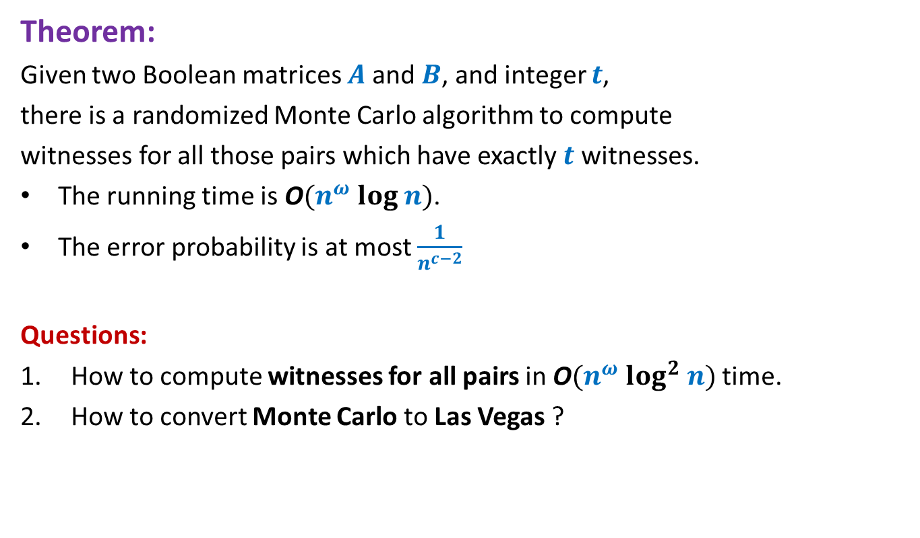

Randomized algorithm for Computing Witnesses for all pairs with witness count
$$∈[t,2t)$$
Compute-Witnesses($A$,$B$,$t$)
{
{ $R$← Sample($n$, $1/t$);
For each $i,k∈[n]$
if $k∈R$ then $A_{ik}$← $k$∙ $A_{ik}$;
else $A_{ik}$←0;
$D′$← $A$ ∙ $B$;
For each $i,j∈[n]$
If $D_{ij}^{′}$ is a witness for ($i,j$)
$W_{ij}$← $D_{ij}^{′}$
}
}
Time complexity: O$(n^{ω})$
Probability of failing to find a witness for a single pair ($i,j$): ??
How to reduce the error probability to $<\frac{1}{n^{c}}$ ?
Repeat the entire process ${c log}_{8/7} n$ times.
$$<1−\frac{1}{8}<\frac{7}{8}$$

Slide 40
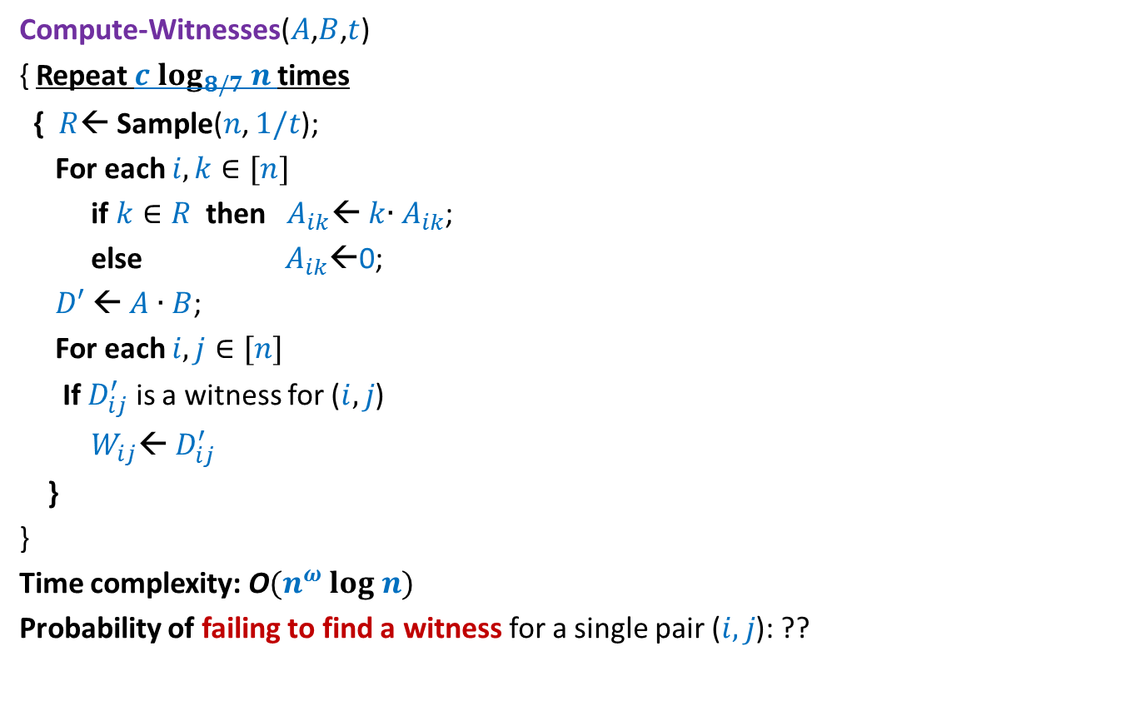
Randomized algorithm for Computing Witnesses for all pairs with witness count
$$∈[t,2t)$$
Compute-Witnesses($A$,$B$,$t$)
{ Repeat $c log_{8/7} n$times
{ $R$← Sample($n$, $1/t$);
For each $i,k∈[n]$
if $k∈R$ then $A_{ik}$← $k$∙ $A_{ik}$;
else $A_{ik}$←0;
$D′$← $A$ ∙ $B$;
For each $i,j∈[n]$
If $D_{ij}^{′}$ is a witness for ($i,j$)
$W_{ij}$← $D_{ij}^{′}$
}
}
Time complexity: O$(n^{ω} log n)$
Probability of failing to find a witness for a single pair ($i,j$): ??
$$<\frac{1}{n^{c}}$$

Slide 41
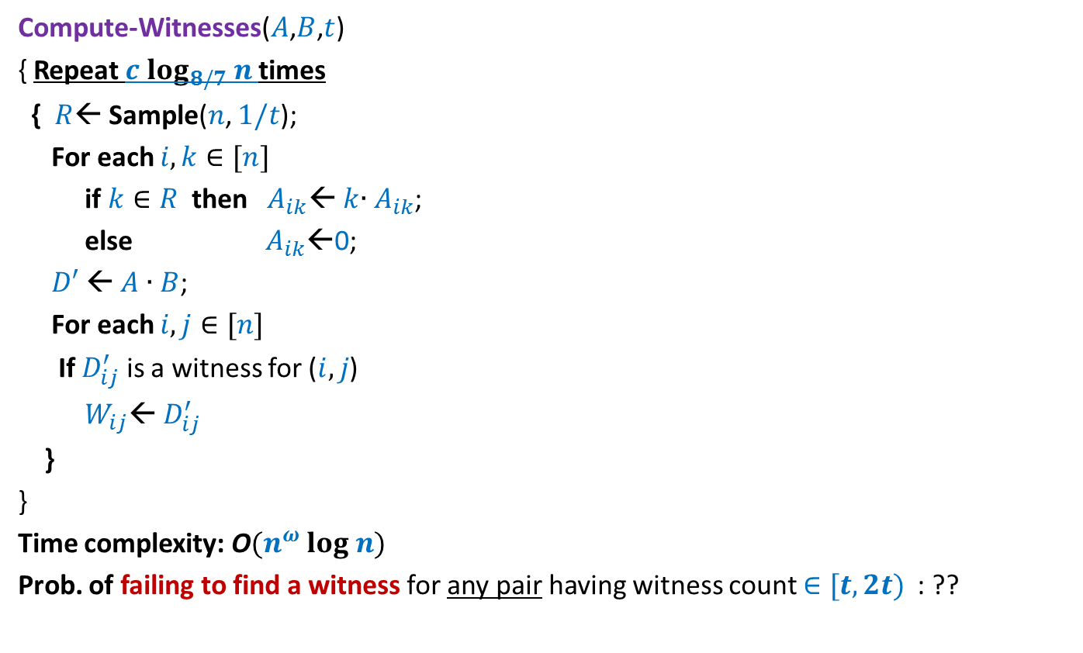
Randomized algorithm for Computing Witnesses for all pairs with witness count
$$∈[t,2t)$$
Compute-Witnesses($A$,$B$,$t$)
{ Repeat $c log_{8/7} n$times
{ $R$← Sample($n$, $1/t$);
For each $i,k∈[n]$
if $k∈R$ then $A_{ik}$← $k$∙ $A_{ik}$;
else $A_{ik}$←0;
$D′$← $A$ ∙ $B$;
For each $i,j∈[n]$
If $D_{ij}^{′}$ is a witness for ($i,j$)
$W_{ij}$← $D_{ij}^{′}$
}
}
Time complexity: O$(n^{ω} log n)$
Prob. of failing to find a witness for any pair having witness count $∈[t,2t)$ : ??
How to compute witnesses for all pairs in O$(n^{ω} log^{2} n)$ time ?
Let there be $m$ pairs that have exactly $t$witnesses.
Apply Union theorem …
$<\frac{m}{n^{c}}$ < $\frac{1}{n^{c−2}}$

Slide 42
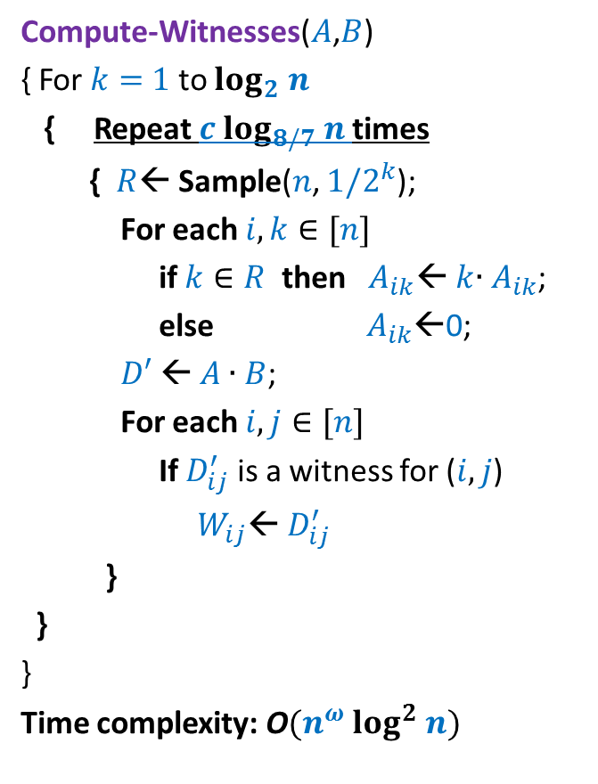
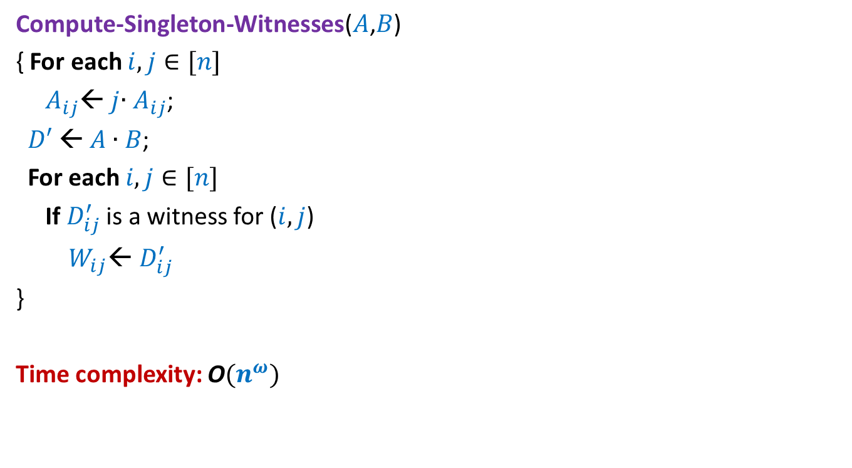
Randomized algorithm for Computing Witnesses for all pairs
Compute-Witnesses($A$,$B$)
{ For $k=$ $1$ to $log_{2} n$
{ Repeat $c log_{8/7} n$times
{ $R$← Sample($n$, $1/2^{k}$);
For each $i,k∈[n]$
if $k∈R$ then $A_{ik}$← $k$∙ $A_{ik}$;
else $A_{ik}$←0;
$D′$← $A$ ∙ $B$;
For each $i,j∈[n]$
If $D_{ij}^{′}$ is a witness for ($i,j$)
$W_{ij}$← $D_{ij}^{′}$
}
}
}
Time complexity: O$(n^{ω} log^{2} n)$
Question:
What is Prob. that witness is not found for a given pair ($i$,$j$) ?
Answer: ?
Question:
What is Prob. that witness is not found for at least one pair ?
Answer:
Expected running time = O$(n^{ω} log^{2} n)$
$$<\frac{1}{n^{c}}$$
$$<\frac{1}{n^{c−2}}$$
How to transform to Las Vegas algo ?
If there is even a single pair with nonzero witnesses but we fail to find even one, run the O$(n^{3})$ algo.

Slide 43
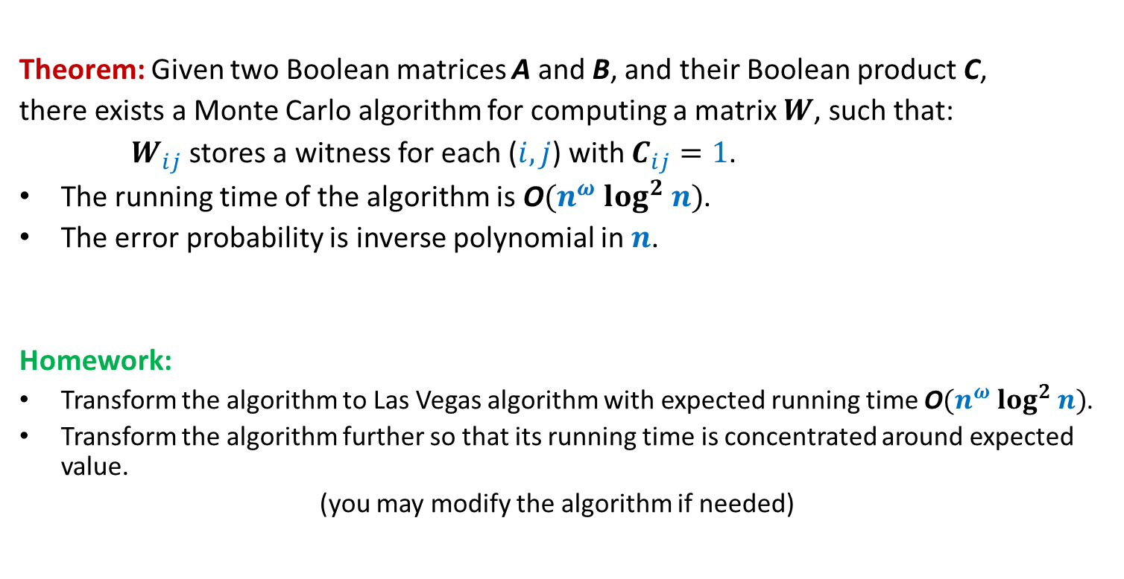
Boolean Product Witness Matrix (BPWM)
Theorem: Given two Boolean matrices A and B, and their Boolean product C,
there exists a Monte Carlo algorithm for computing a matrix $W$, such that:
$W_{ij}$ stores a witness for each ($i,j$) with $C_{ij}=1$.
The running time of the algorithm is O$(n^{ω} log^{2} n)$.
The error probability is inverse polynomial in $n$.
Homework:
Transform the algorithm to Las Vegas algorithm with expected running time O$(n^{ω} log^{2} n)$.
Transform the algorithm further so that its running time is concentrated around expected value.
(you may modify the algorithm if needed)

